Slide 1
Insights Unveiled: Exploring Healthcare Patterns in MIMIC-III Data

Slide 2
Introduction:
The MIMIC-III dataset offers a window into the intricate landscape of healthcare data.
Our journey into this dataset has revealed fascinating trends, disparities, and correlations that give us valuable insights into patient demographics, hospital stays, and medical conditions.
This narrative unveils the story that unfolds through the lens of various plots, each shedding light on different facets of healthcare.

Slide 3
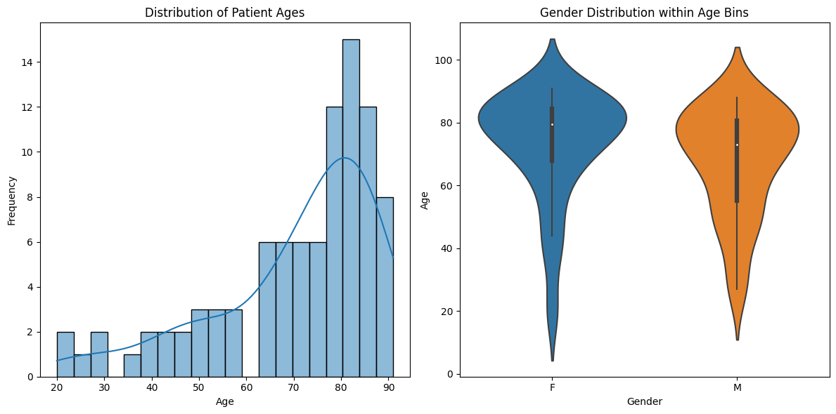
Section 1: Patient Demographics
The story begins by understanding the age distribution of patients using a histogram.
This plot offers a clear picture of the age range of patients in the dataset.
Moreover, a violin plot showcases how gender is distributed within different age bins, allowing us to identify age-related gender patterns.

Slide 4
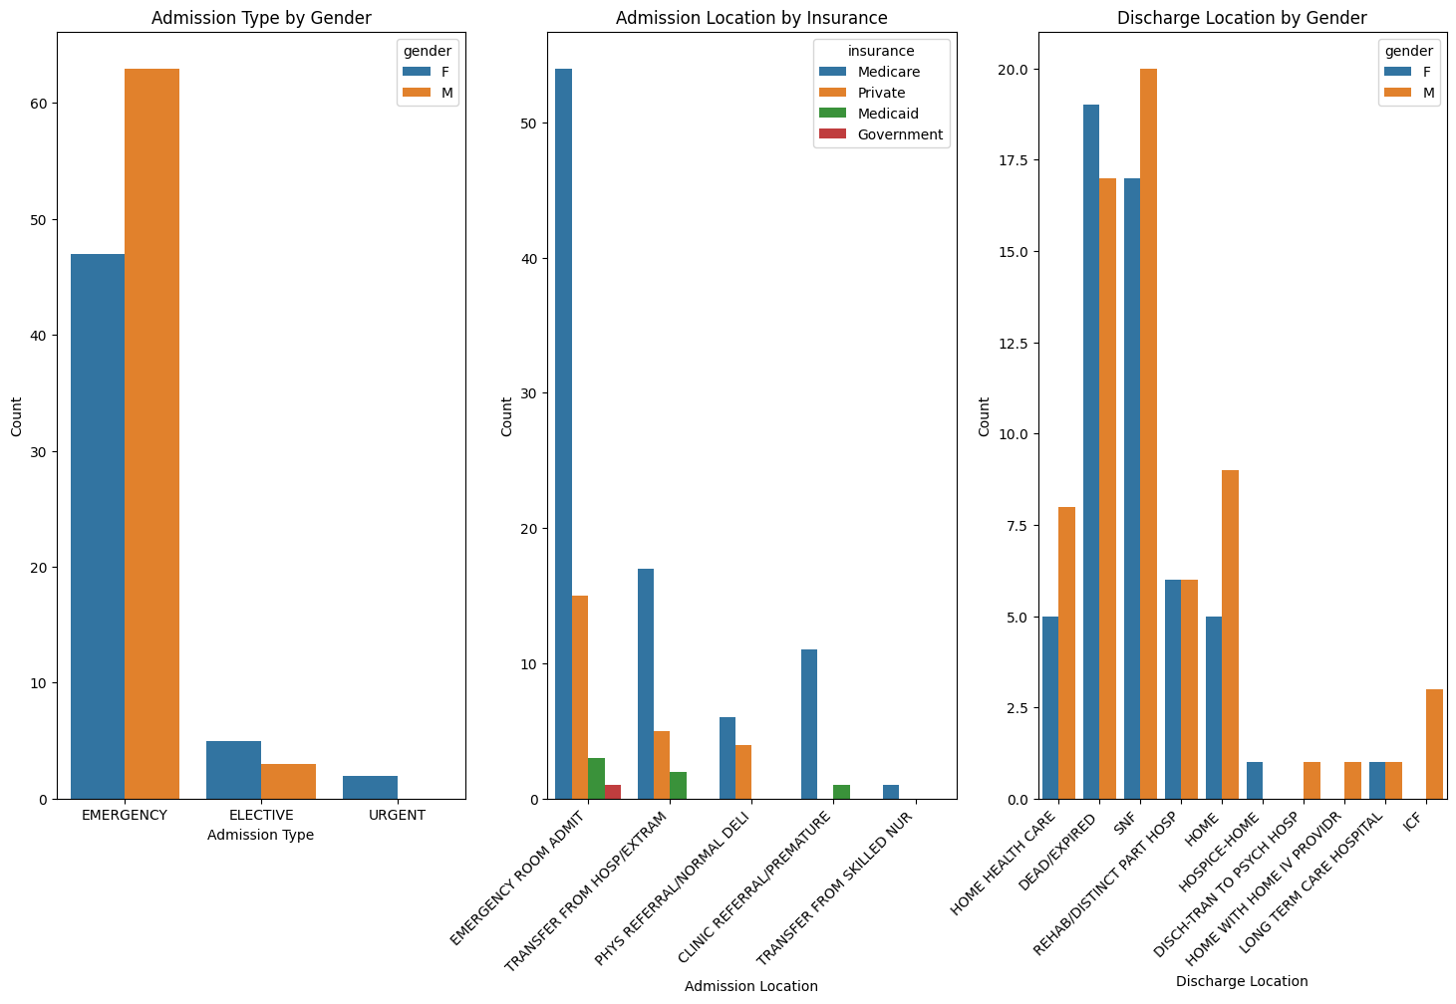
Section 2: Hospital Admissions
Diving into hospital admissions, we uncover the distribution of admission types based on gender using bar plots.
This reveals how different admission types are used for different genders.
Further exploration, shown in a bar plot depicting admission location by insurance type, helps us understand the link between insurance coverage and the location of admission.

Slide 5
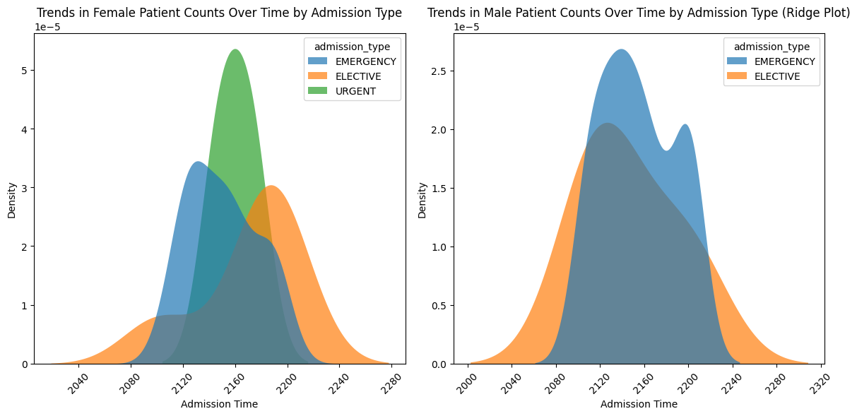
Section 3: Discharge and Trends
The journey continues with a visualization of discharge locations, which demonstrates the varying destinations patients are sent to after hospital stays.
To highlight trends in patient counts, a ridge plot showcases how male and female patient admissions have evolved over time based on admission types.

Slide 6
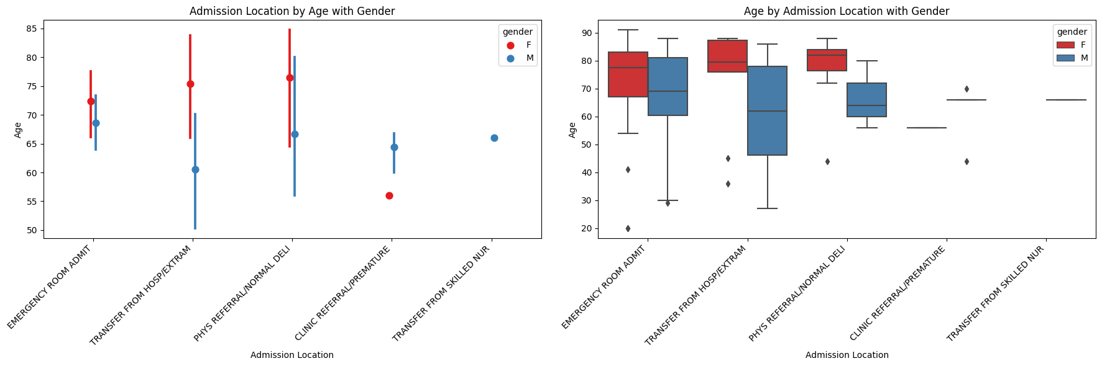
Section 4: Patient Age and Location
To gain deeper insights, we explore the correlation between patient age, admission location, and gender using a point plot.
This plot illustrates how different age groups are distributed across various admission locations and how gender plays a role in this distribution.
In addition, a box plot adds depth by showcasing the distribution of patient ages by admission location and gender.

Slide 7
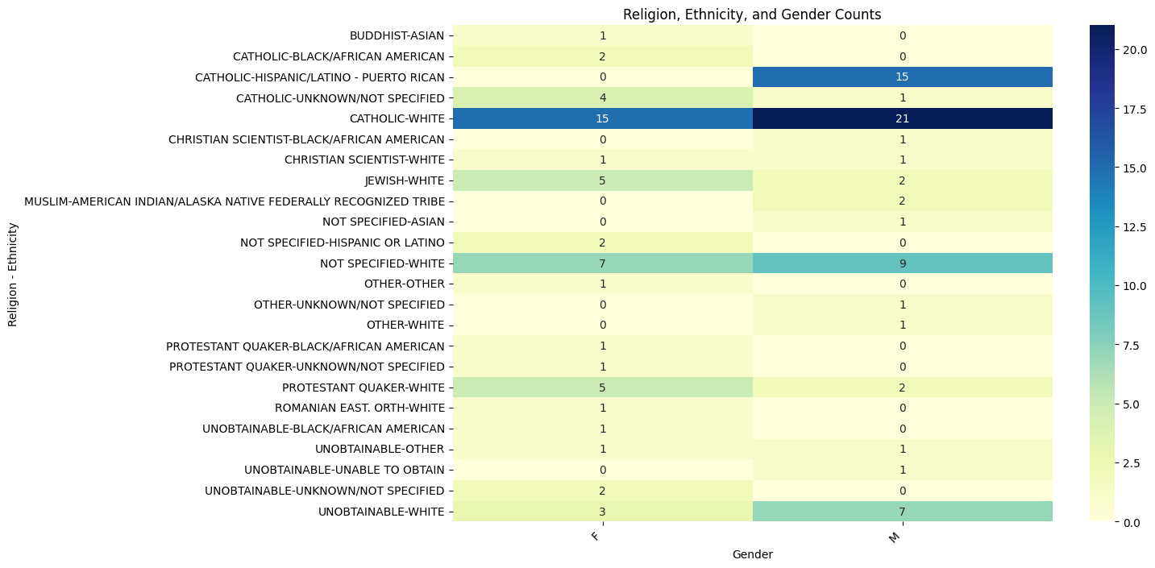
Section 5: Diversity in Patient Attributes
We delve into the intricacies of patient attributes with a heatmap illustrating the relationship between race, religion, and gender.
This visualization helps us understand the distribution of these attributes and the potential intersections.

Slide 8
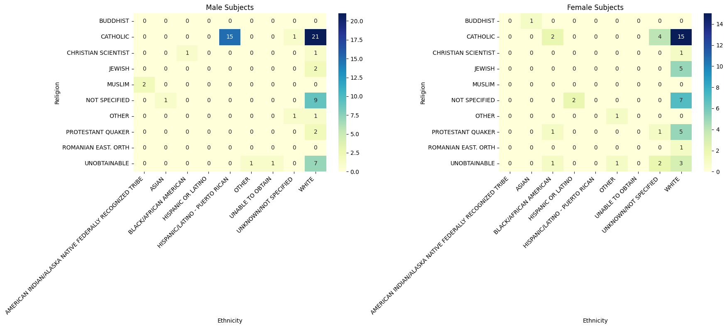
Section 5: Diversity in Patient Attributes (cont)
Another way of visualizing heatmap

Slide 9
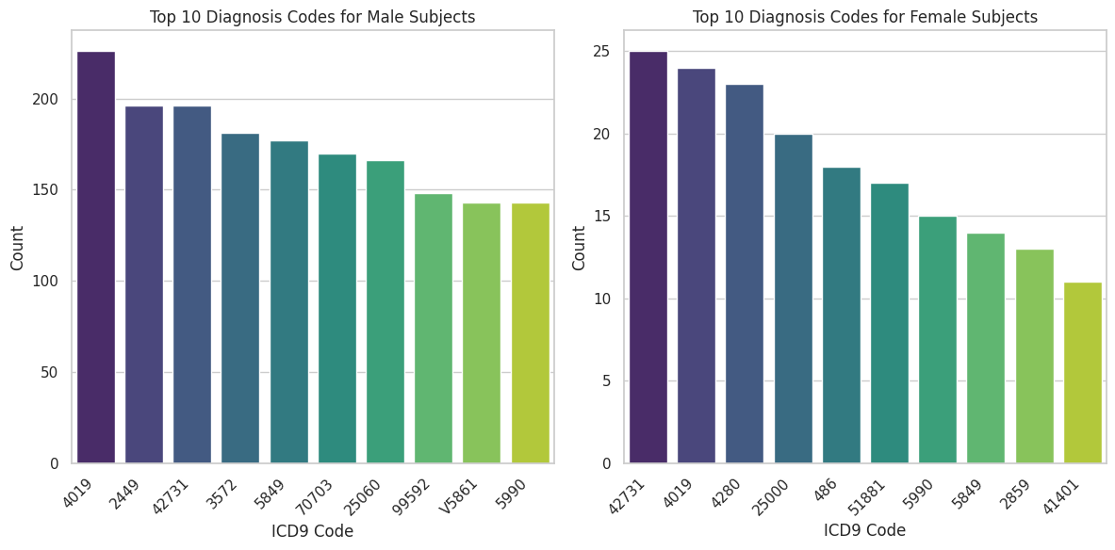
Section 6: Diagnoses and Medical Trends
Turning our focus to medical diagnoses, we present the top 10 diagnosis codes for both male and female patients.
These bar plots unveil the most prevalent medical conditions for each gender, offering insights into potential gender-specific health concerns

Slide 10
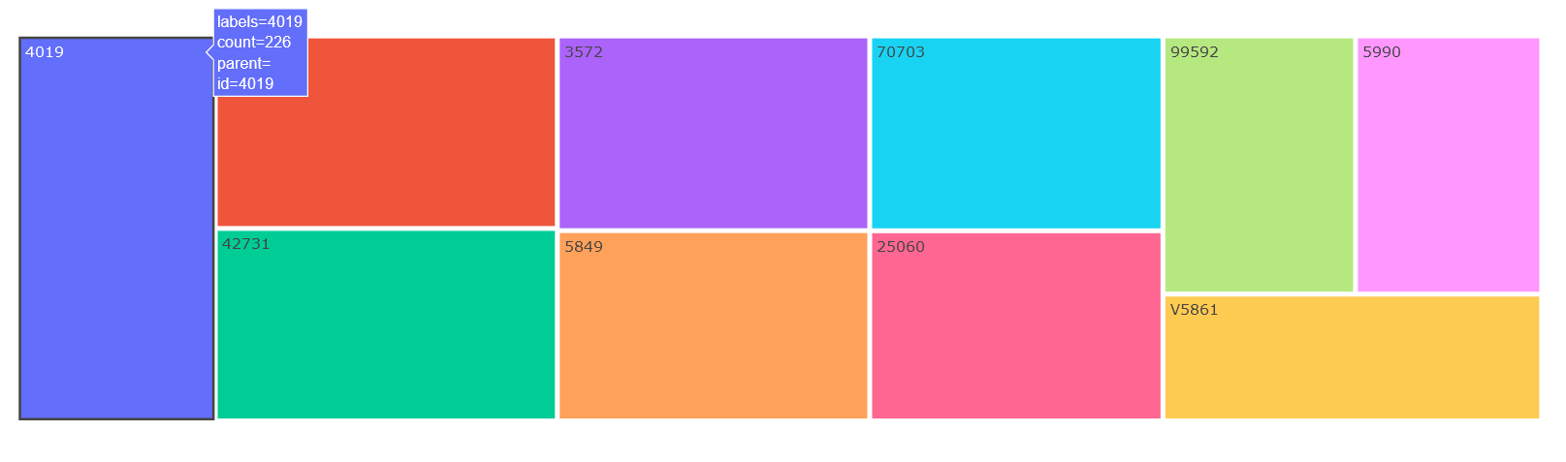
Section 6: Diagnoses and Medical Trends (cont)
Another way of plotting is by using a different library Plotly.
The main advantage of it is being interactive.
Rolling over mouse pointer will display all the related details

Slide 11
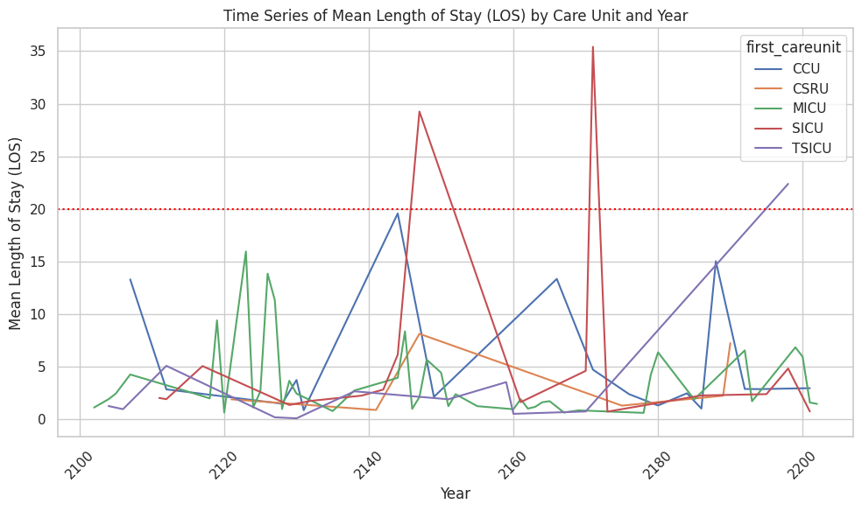
Section 7: Length of Stay Analysis
Exploring the length of hospital stays, a time series plot showcases the mean length of stay by care unit and year.
This provides a comprehensive view of trends over time, potentially reflecting changes in patient care and outcomes.
A horizontal line representing threshold can be plotted to indicate warning

Slide 12
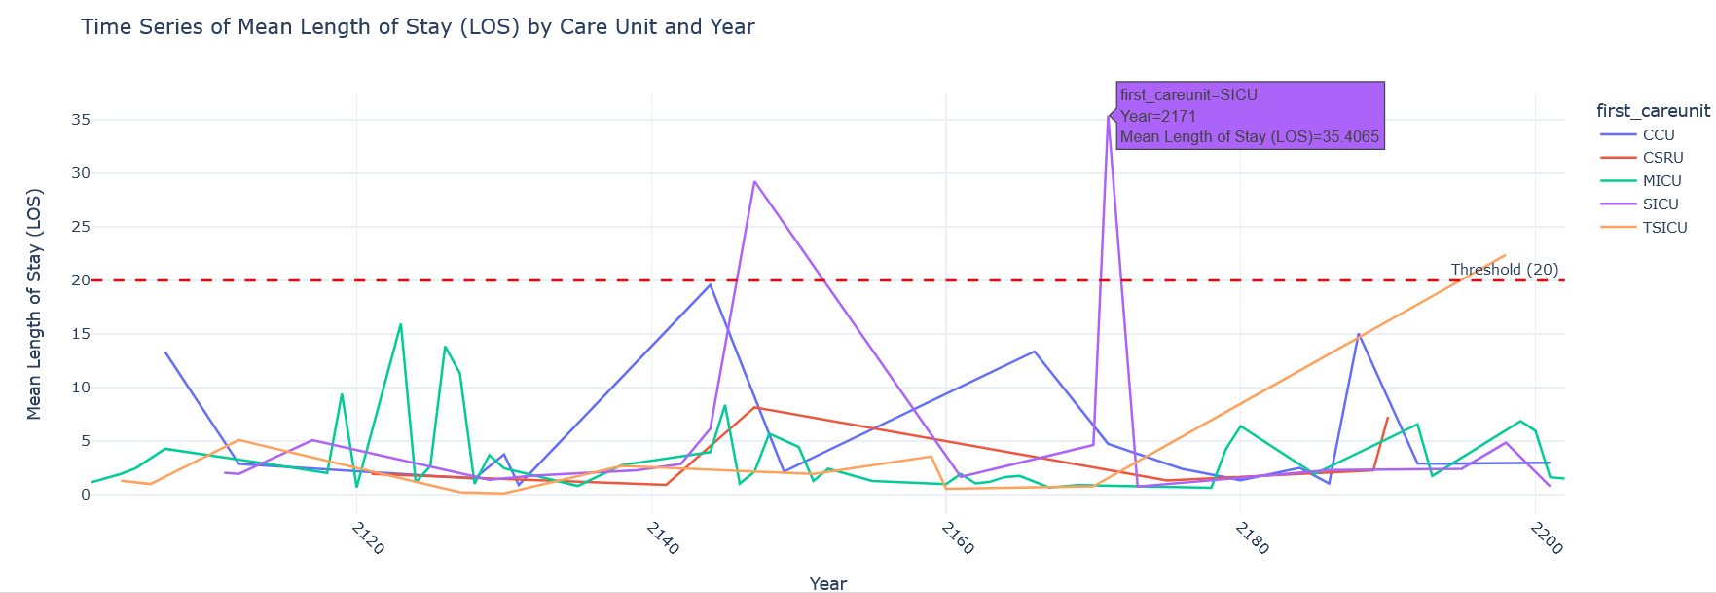
Section 7: Length of Stay Analysis (cont)
A more interactive plot can be drawn using Plotly

Slide 13
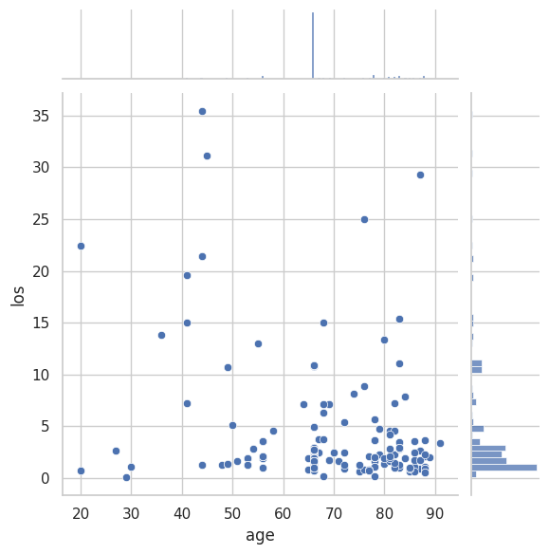
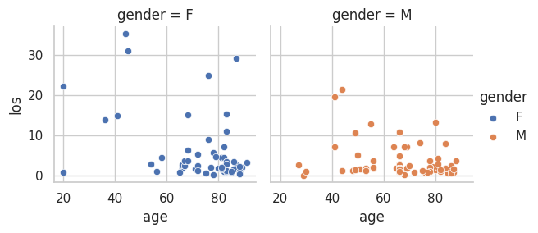
Section 8: Correlations and Scatter Plots
Concluding our journey, we investigate correlations between age and length of stay using scatter plots.
Seaborn FacetGrid can be a powerful tool for creating a grid of subplots, allowing you to visualize relationships in your data across multiple categorical variables.
Separate jointplots for males and females give us a nuanced understanding of how age and length of stay relate to each other.

Slide 14
Conclusion: A Multifaceted Journey of Insights
As we step back from our expedition, we're left with a profound understanding of healthcare's multifaceted nature.
The plots, each a brushstroke on the canvas of data, have revealed intricate connections between age, gender, admissions, and medical conditions.
Armed with these insights, healthcare stakeholders are better equipped to shape a more equitable and informed healthcare landscape.

